Slide 1
Blackboard Architecture 101
Chi-Hao Kuo

Slide 2
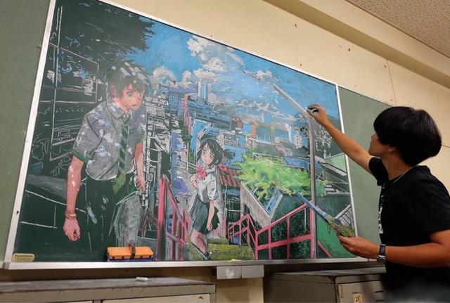
What Is Blackboard ?

Slide 3
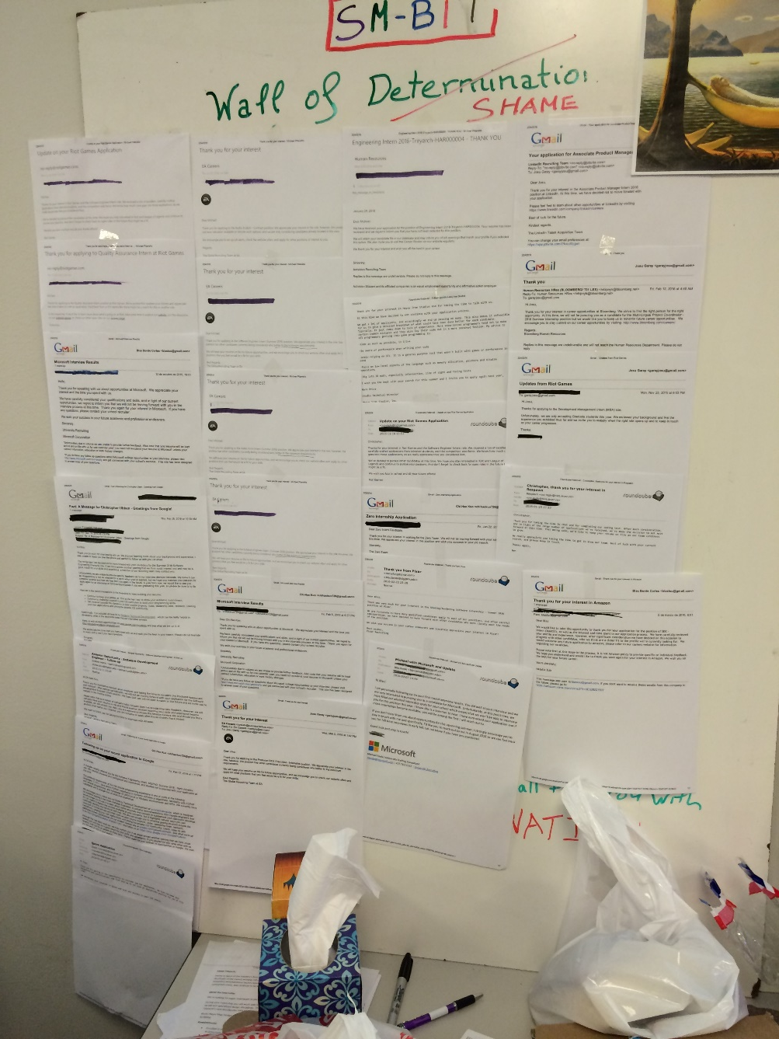
What Is Blackboard ?
Physical blackboard
Publicly read/writeable
Possibly organized
More like a bulletin board
Post requests and information
Respond to items of interest

Slide 4
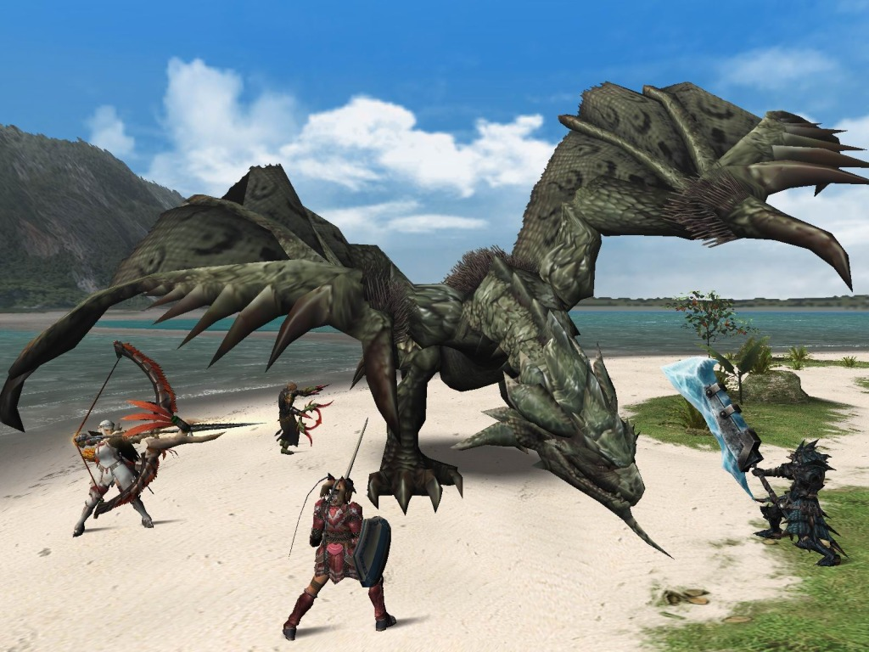
Blackboard Architecture 101
Think about a situation:
Hunters coordinate to fight a monster
Different classes matter
How to form formation
How to determine strategy based on each character’s skill and position

Slide 5


Blackboard Architecture 101
Each agent talks to each other
2 agents : 1 communication
3 agents : 3 communications
4 agents : 6 communications
…..
$\frac{n(n−1)}{2}$
That’s O($n^{2}$) !!!

Slide 6

Blackboard Is Shared Memory
Read/write memory
Working memory
Like a hard-drive
Like a database
No processing (other than sorting)
Maybe not

Slide 7

Blackboard For Communication
Centralized communication
Agents communicate
Sub-systems of an agent communicate

Slide 8
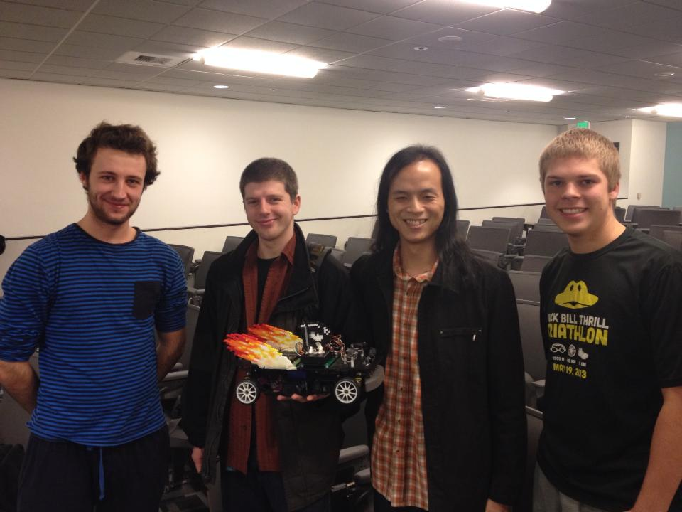
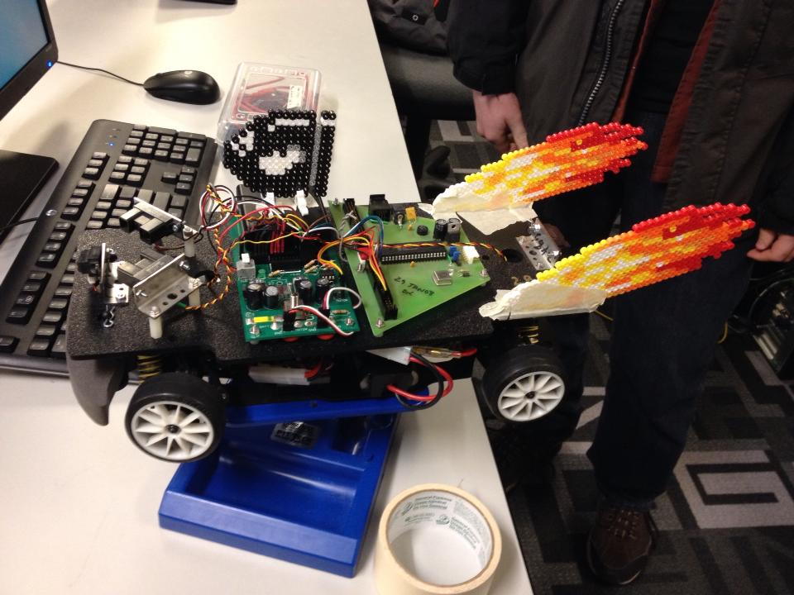
Blackboard Pattern

Slide 9
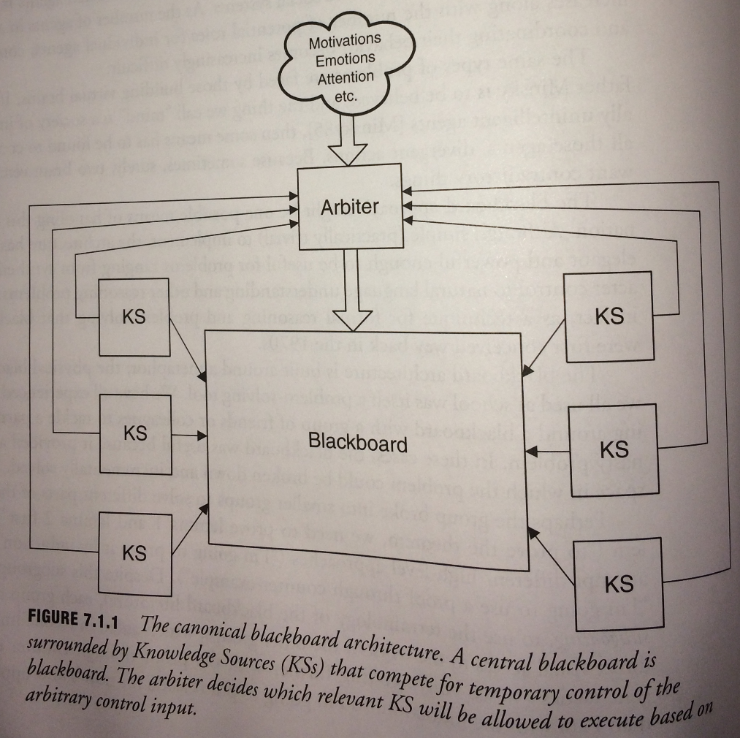
Blackboard Pattern

Slide 10
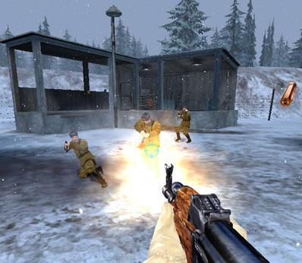
Problem : Agents Doing Same Thing At Same Time
Soldiers Crouching
Random chance of crouch
Dodge roll into crouch
Crouch to get out of firing line

Slide 11
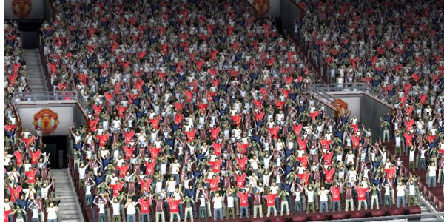
Problem : Agents Doing Things Too Often
Crowd in FIFA games
NPCs in GTA series

Slide 12

Problem : Pick Roles For Formations
Military diamond formation
…Or just to fight zombies

Slide 13
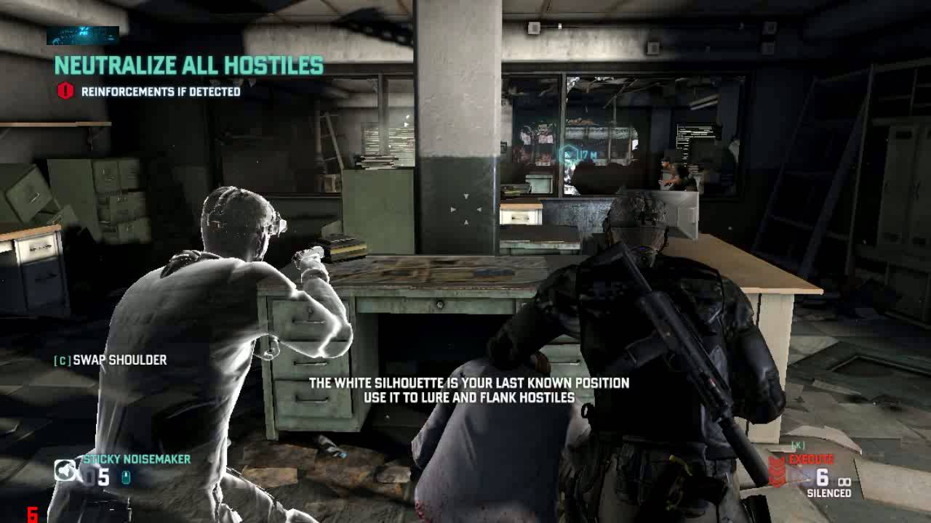
Blackboard As Shared Memory Space
What to store?

Slide 14
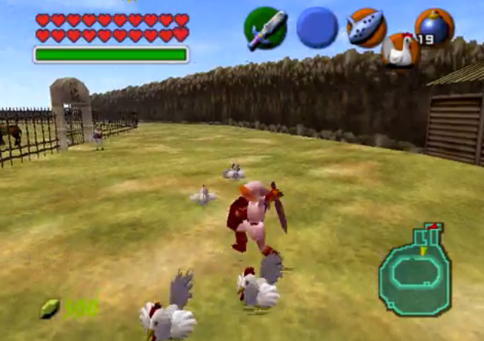

Blackboard As Shared Memory Space
What to store?

Slide 15
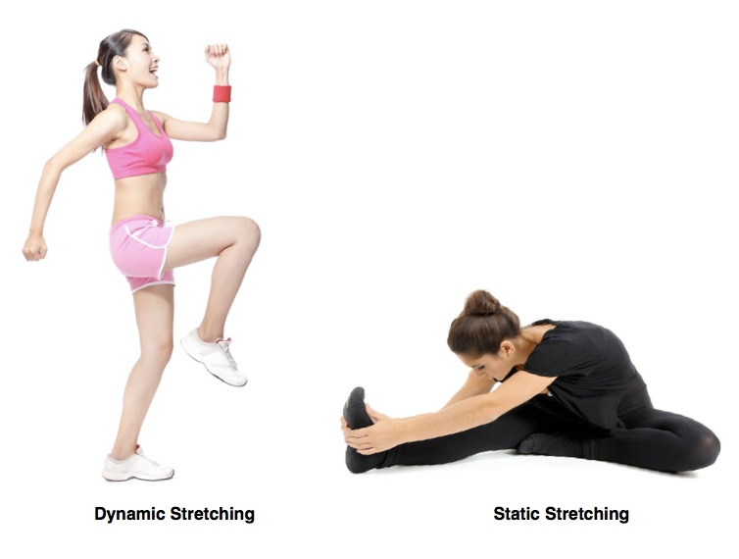
Blackboard Implementation
Two types:
Static
Dynamic

Slide 16
Static Blackboard
class MyBlackBoard {
public:
MyBlackBoard();
~MyBlackBoard();
// getters/setters
...
private:
float m_health;
Vector2 m_pos;
Vector2 m_dir;
};

Slide 17
Static Blackboard
Predetermined data to share.
Static amount of data.
Best for intra-agent coordination.

Slide 18
Dynamic Blackboard
Data to share is not predetermined.
Dynamic amount of data.
Best for inter-agent coordination.
Also useful for intra-agent complex reasoning.

Slide 19

Dynamic Blackboard Implementation

Slide 20
Dynamic Blackboard Implementation in C
typedef enum DataTypeC {
TYPE_NONE, /* type not specified (default) */
TYPE_INT,
TYPE_BOOL,
TYPE_FLOAT,
TYPE_CUSTOM, /* user-defined type */
/* add more types here */
} DataType;

Slide 21
Dynamic Blackboard Implementation in C
typedef struct MyDataC {
union {
int m_int;
bool m_bool;
float m_float;
void *m_data;
};
enum DataType m_type;
} MyData;

Slide 22
Dynamic Blackboard Implementation in C
typedef struct BlackBoardC
{
MyData *mydata; /* dynamic allocated data array */
unsigned num_data; /* number of data reserved */
} MyBlackBoard;
void ReserveDataBB(unsigned num); /* reserve data array */
MyData *GetDataBB(unsigned index); /* get n-th data */
void FreeBlackBoard(void); /* free memory */

Slide 23
Dynamic Blackboard Implementation in C
void MyDataC_Reset(MyData *mydata); /* reset data and free allocated memory */
bool MyDataC_IsValid(const MyData *mydata); /* check if data is already set */
bool MyDataC_IsType(const MyData *mydata, DataType type); /* check is data is the correct type */
/* getters */
void MyDataC_SetInt(MyData *mydata, int value);
void MyDataC_SetBool(MyData *mydata, bool value);
void MyDataC_SetFloat(MyData *mydata, float value);
void MyDataC_Set(MyData *mydata, DataType type, void *value);
/* setters */
bool MyDataC_GetInt(const MyData *mydata, int *value);
bool MyDataC_GetBool(const MyData *mydata, bool *value);
bool MyDataC_GetFloat(const MyData *mydata, float *value);
bool MyDataC_Get(const MyData *mydata, DataType type, void **value);

Slide 24
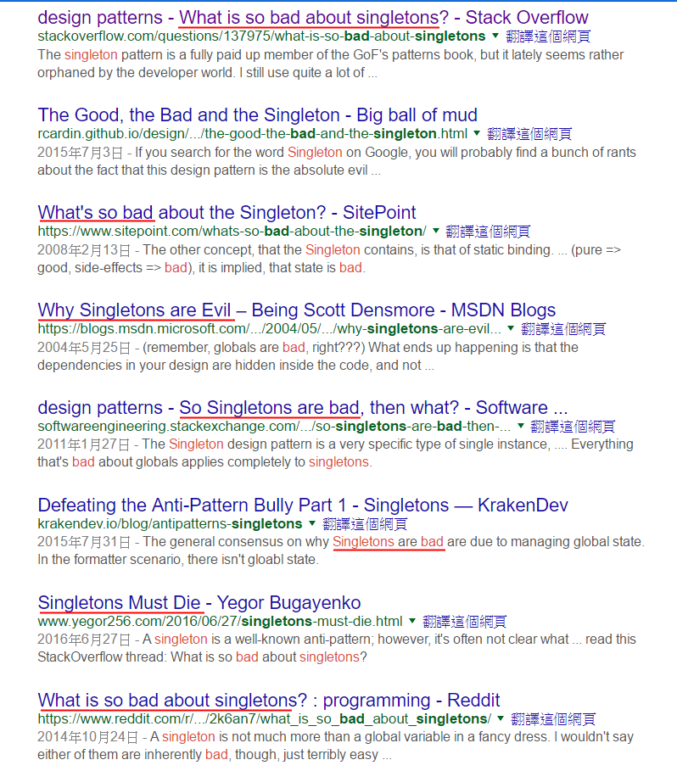
Singleton

Slide 25
Singleton in C
/* C-style singleton */
MyBlackBoard *GetBBInstance(void)
{
static MyBlackBoard *bb = 0;
if (bb == 0) {
bb = (MyBlackBoard *)malloc(sizeof(MyBlackBoard));
bb->num_data = 0;
}
return bb;
}

Slide 26
Dynamic Blackboard Implementation in C++
typedef void (*MyDataUpdateFunc)(Agent *agent);
struct MyData {
union {
int m_int;
bool m_bool;
float m_float;
void *m_data;
};
DataType m_type;
MyDataUpdateFunc m_updateFunc; // update function
};

Slide 27
Dynamic Blackboard Implementation in C++
class MyBlackBoard {
public:
MyBlackBoard();
~MyBlackBoard();
bool SetData(const std::string &name, MyData &mydata);
MyData *GetData(const std::string &name);
private:
std::vector<MyData *> m_datas; // dynamic allocated data array
std::unordered_map<std::string, unsigned> m_hashtable; // hash table for data
bool HasData(const std::string &name);
};

Slide 28
Better Singleton
template <typename T> class Singleton_Deleter {
public:
void operator()(const T * const instance) { delete instance; }
};
template <typename T> class Singleton {
public:
static T &GetInstance(void) {
static std::unique_ptr<T, Singleton_Deleter<T>> instance_ptr = std::make_unique<T>();
return *instance_ptr;
}
private:
Singleton() {}
};

Slide 29
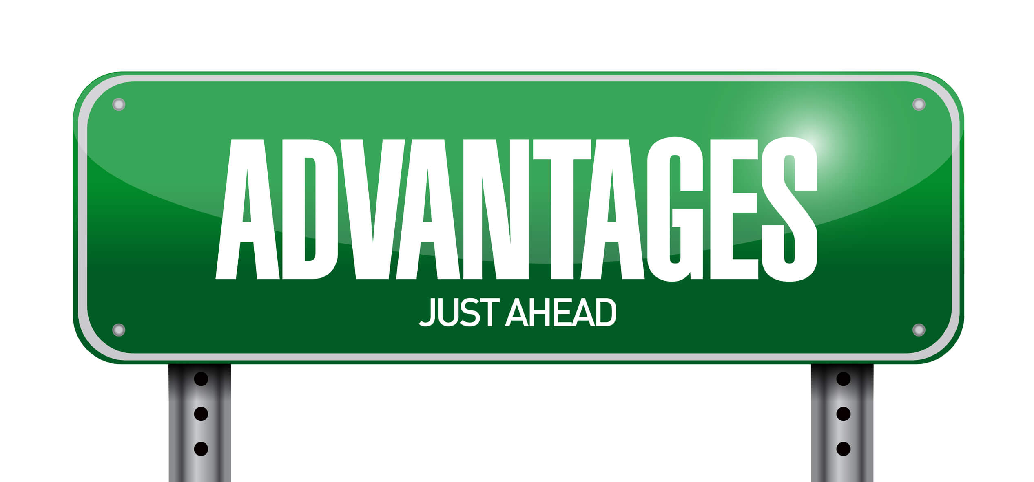
Blackboard Advantages
Decouple data from logics.
Easier for design change.
Performance.

Slide 30
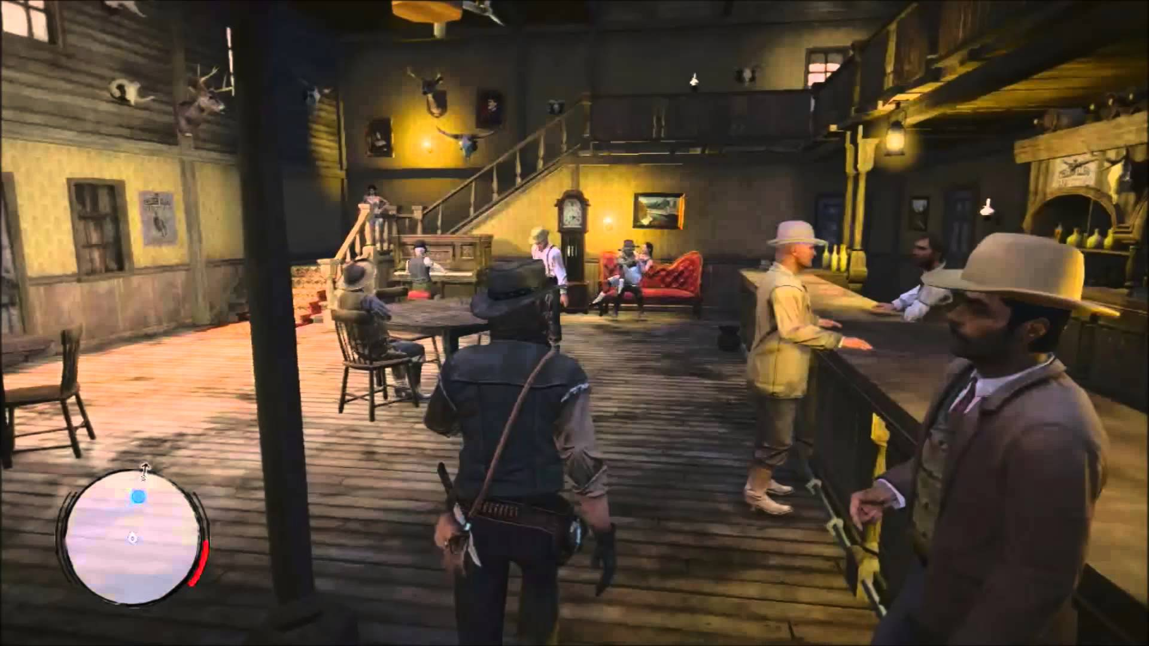
Blackboard Advantages

Slide 31
Blackboard Architecture 101
Reference:
http://www.jorkin.com/talks/UT_blackboards.zip
"Blackboard Architectures" - AI Game Programming Wisdom
"Simple Techniques for Coordinated Behavior“ - AI Game Programming Wisdom 2
"Using a Static Blackboard to Store World Knowledge" - AiGameDev.com

